Slide 1

IP Security

Slide 2
IP Security
IPSec provides the capability to secure communications across a LAN, across private and public wide area networks (WANs) and across the Internet.

Slide 3
Security in the Internet Architecture
Lack of security in the Internet Architecture
Security was left up to the applications
With the passage of time it was realized that universal security at the IP level will become a need and not a luxury

Slide 4
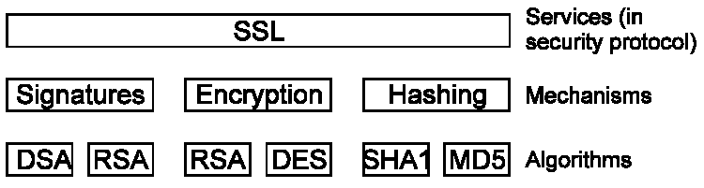
Services, Mechanisms, Algorithms
A typical security protocol provides one or more services
Services are built from mechanisms
Mechanisms are implemented using algorithms

Slide 5
What is IPSec?
Internet Protocol Security (IPsec) is a secure network protocol suite that authenticates and encrypts the packets of data sent over an internet protocol network. It is used in virtual private networks (VPNs).
Applicable to both IP Version 4 and IP Version 6
IPSec available in Windows 2000, Linux, Cisco Routers, etc.

Slide 6
Applications of IPSec
Secure Branch Office Connectivity Over the Internet
Secure Remote Access Over the Internet
Establishing Extranet and Intranet Connectivity with Business partners
Enhancing Electronic Commerce Security

Slide 7
Benefits of IPSec
When IPsec is implemented in a firewall or router, it provides strong security that can be applied to all traffic crossing the perimeter.
IPsec is below the transport layer (TCP, UDP) and so is transparent to applications.
IPsec can be transparent to end users.
IPsec can provide security for individual users if needed.

Slide 8
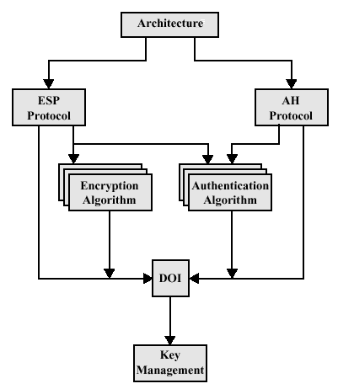
IP Security Architecture
IPSec provides security services at the IP layer by enabling a system to select required security protocols, determine the algorithms to use for the services, and put in place any cryptographic keys required.

Slide 9
AH and ESP
Authentication Header(AH)
The Authentication Header provides support for data integrity and authentication of IP packets
Encapsulating Security Payload(ESP)
The Encapsulating Security Payload provides confidentiality services, including confidentiality of message contents and limited traffic flow confidentiality. As an optional feature, ESP can also provide the same authentication service as AH.

Slide 10
Transport and Tunnel Modes
Transport mode – used to protect upper layer payloads of an IP packet (tcp, udp)
Tunnel mode – used to protect an entire IP packet including its payload (VPN)

Slide 11
Transport and Tunnel Modes
Tunnel Mode means that one outgoing IP packet is encapsulated in another packet with typically a different IP destination
Tunnels can be
Router to Router
Router to host or host to router
Host to host

Slide 12
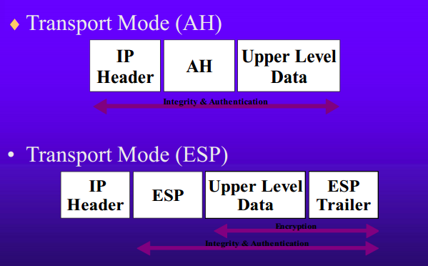
Transport Mode

Slide 13
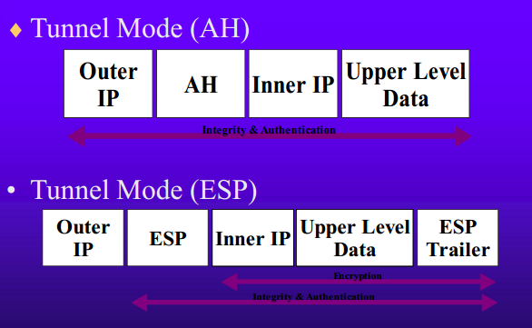
Tunnel Mode

Slide 14
Conclusion
IPSec provides Universal IP level security for all applications
Two choices are available AH and ESP
IPSec can be used in a transport mode for end to end authentication and encryption or in tunnel mode for router to router authentication and encryption
IPSec can be implemented IPV4 as options and is a required part of the implementation of IPV6

